Slide 1


Department of BES-I
COURSE: Data Structures through Python
COURSE CODE: 24SC1204
Topic:
Name of the topic:
AVL TREES
Session – 29

Slide 2



AIM OF THE SESSION
To familiarize students with the basic concept of AVL Trees
INSTRUCTIONAL OBJECTIVES
This Session is designed to:
Demonstrate the AVL Trees
List out the operations possible on the AVL Trees.
Describe the each operation
Describe the rotations of AVL Trees.
LEARNING OUTCOMES
At the end of this session, you should be able to:
Define AVL Trees
Describe four rotations of AVL Trees and their operations
Summarize definition, types and operations of AVL Trees and its applications

Slide 3
AVL TREES
INTRODUCTION:
AVL Tree is invented by Adelson - Velsky and Landis in 1962. The tree is named AVL in honour of its inventors. AVL trees are nothing but self-balancing binary search trees.
Self-balancing tree?
The height of the left and the right sub trees of every node differs by at most 1, which implies the difference between the heights will always be either 1,0 or -1.
Balance Factor = (Height of Left Subtree - Height of Right Subtree)

Slide 4
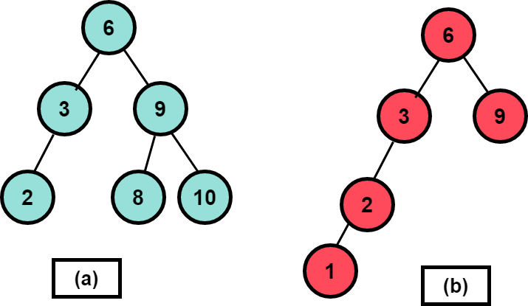
Example of AVL Trees
  (a)The tree in figure (a) is an AVL tree. As you can see, for every node, the height difference between its left sub tree and right sub tree does not exceed mod(1).
  (b). The tree in figure (a) is an AVL tree. As you can see, for every node, the height difference between its left sub tree and right sub tree does not exceed mod(1).

Slide 5
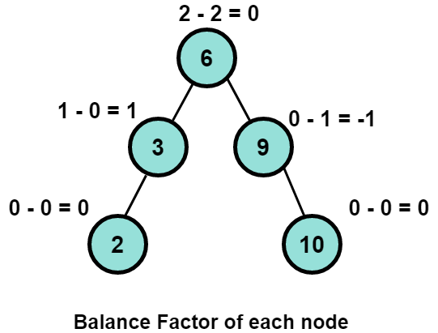
SESSION DESCRIPTION
In given example, the balance factor of every node is between -1 and +1. So, it is an AVL tree.
While performing AVL Tree we should follow the balance factor properties..
Properties of Balance Factor
If a sub tree has a balance factor>0, then the sub tree is called left-heavy as the height of the left sub tree is greater than the height of its right sub tree, so the left sub tree has more nodes than the right sub tree.
If a sub tree has a balance factor<0, then the sub tree is called right-heavy as the height of the left sub tree is smaller than the height of its right sub tree, so the right sub tree has more nodes than the left sub tree.
If the balance factor=0, the sub tree is perfectly balanced, with both left and right sub trees having equal heights.

Slide 6
SESSION DESCRIPTION (Cont..)
Operations on AVL tree:
1.Insertion
2.Deletion
3.Search
Insertion: Insertion in AVL tree is performed in the same way as it is performed in a binary search tree. However, it may lead to violation in the AVL tree property and therefore the tree may need balancing. The tree can be balanced by applying rotations.
Deletion: Deletion can also be performed in the same way as it is performed in a binary search tree. Deletion may also disturb the balance of the tree therefore, various types of rotations are used to rebalance the tree.
Search: The search operation in the AVL tree is similar to the search operation in a Binary search tree

Slide 7
SESSION DESCRIPTION (Cont..)
We perform rotation in AVL tree only in case if Balance Factor is other than -1, 0, and 1.
There are basically four types of rotations which are as follows:
AVL ROTATIONS:
Left Rotation (LL - Single Rotation)
Right Rotation (RR - Single Rotation)
Left-Right Rotation (LR - Double Rotation)
Right-Left Rotation (RL - Double Rotation)

Slide 8
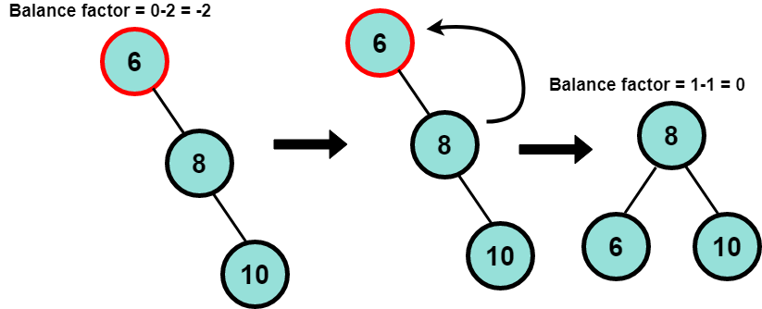
ROTATIONS
Given elements are 6,8,10.
Tree will be looks in the given way here the tree is not balance so we need perform the rotation here.i.e.,
Left Rotation (LL - Single Rotation)
Node 6 has a balance factor of -2 after the insertion of node 10. After a single rotation towards the left, node 8 becomes the root and node 6 becomes its left child. By doing this, the BST property also remains intact, and the tree becomes height-balanced.
Left-rotation is applied in given example

Slide 9
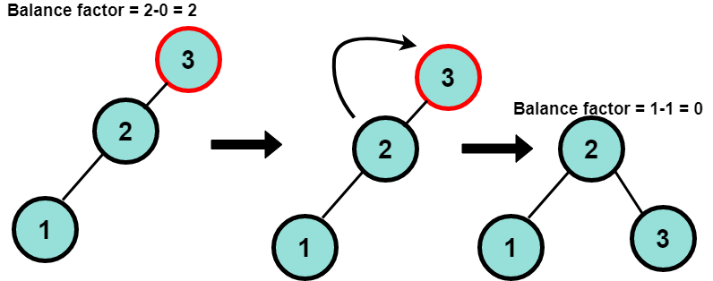
ROTATIONS(Cont..)
Given elements are 3,2,1.
Tree will be looks in the given way here the tree is not balance so we need perform the rotation here.i.e.,
Right Rotation (RR - Single Rotation)
Node 3 has a balance factor of 2, so it is unbalanced. After a single rotation towards the right, node 2 becomes the root and node 3 becomes its right child. And the new root, i.e., node 2, has a balance factor of 0. Hence, the tree becomes balanced.
Right-rotation is applied in given example

Slide 10
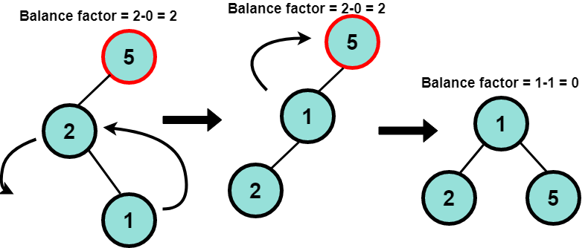
ROTATIONS(Cont..)
Given elements are 5,2,1.
Tree will be looks in the given way here the tree is not balance so we need perform the rotation here.i.e.,
Left-Right Rotation (LR - Double Rotation)
Node 1 is inserted as the left child of node 2, which is the right child of node 5. See that the balance factor of node 5 becomes 2 after insertion of node 1. Firstly, we do a left rotation, but the tree is still not balanced. If you see carefully, the tree is left heavy after this step, so we need a right rotation. After which node 1, i.e. the newly inserted node, becomes the root.
Left-Right Rotation is applied in given rotation

Slide 11
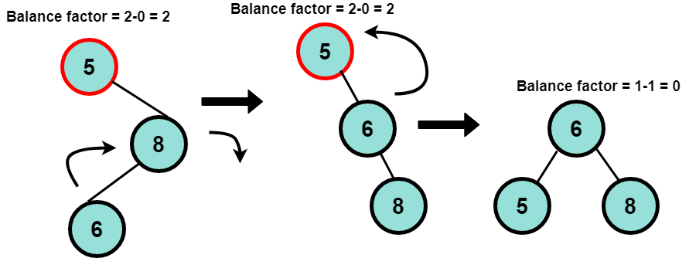
ROTATIONS(Cont..)
Given elements are 5,8,6.
Tree will be looks in the given way here the tree is not balance so we need perform the rotation here.i.e.,
Right-Left Rotation (RL - Double Rotation)
The insertion of node 6 creates an imbalance. Firstly, we perform a right rotation which makes node 6 a parent of node 8 and node 8 becomes the right child of node 6. Next, we perform left rotation on the resulting right-heavy tree and finally, the tree becomes balanced.
Right-Left Rotation is applied in given rotation

Slide 12

EXAMPLE
You are tasked with building an AVL tree that maintains the alphabetical order of the months January, February, March, April, May, and June. You need to start with January as the root node and efficiently insert the remaining months while ensuring the tree remains balanced. Describe the sequence of insertions and any necessary rotations, explaining why each rotation is performed and how it restores balance.

Slide 13
SUMMARY
AVL Tree is a height-balanced BST that maintains its height by performing tree rotations according to a Balancing Criteria.
Balancing Criteria: For all nodes, the sub tree height difference (balance factor) should be at most 1
The valid values of the balance factor are -1, 0, and +1.
The insert and delete operation require rotations to be performed after violating the balance factor.
The balance factor of a node is defined as the difference between the height of the left and right sub tree of that node.
Tree Rotations are changes in the structure of the tree, done only on 3 nodes without affecting the elements' order.

Slide 14
SELF-ASSESSMENT QUESTIONS
1.How to calculate the balance factor of a node in an AVL Tree?
a)height of the left sub tree - height of the right sub tree
b)height of the right sub tree - height of the left sub tree
c) absolute difference between the heights of the left and right sub trees.
d)sum of the heights of the left and right sub trees.
2.What is the primary purpose of rotations in AVL Trees?
a)To increase the overall height of the tree.
b)To maintain a balanced structure and ensure efficient operations.
c)To create a perfectly symmetrical tree shape.
d)To sort the nodes in ascending or descending order.

Slide 15
TERMINAL QUESTIONS
Describe About AVL Trees?
Explain the concept of balance factor in an AVL tree. What are the acceptable values for a node's balance factor?
Describe the four different types of rotations in an AVL tree (left, right, double left, double right). When is each type of rotation used?
Given a sequence of elements, construct an AVL tree by inserting them one by one. Explain your choices for insertion order and justify any performed rotations.

Slide 16
REFERENCES FOR FURTHER LEARNING OF THE SESSION
Reference Books:
1. Data Structures and Algorithm Analysis in PYTHON, 2010, Mark Allen Weiss, Second Edition, Pearson Education.
2. Data Structures and Algorithms, A.V.Aho, J.E.Hopcroft, and J.D.Ullman, Pearson Education, First Edition Reprint2003.
3. Advanced Guide to Python 3 Programming, John Hunt, 4th Edition, Springer Nature Switzerland AG 2019.
4. Python Basics: A Practice Introduction to Python 3, David Amos, Dan Bader, Joanna Jablonski, Fletcher Heisler, 4th edition, Real Python.
Sites and Web links:
1. https://docs.python.org/3/tutorial/datastructures.html
2. https://www.w3schools.com/dsa/dsa_intro.php
3. https://www.geeksforgeeks.org/python-data-structures/

Slide 17
THANK YOU
Team – Data Structures through Python

